Slide 1

Unpacking the Departments of Education and Justice School Discipline Guidance Package
School Justice Leadership Summit
April 3, 2014
Kaitlin Banner

Slide 2
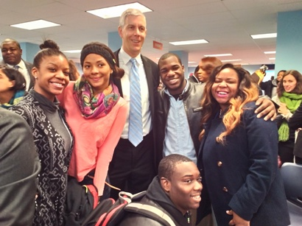
School Discipline Guidance Release
On January 8, Secretary of Education Arne Duncan and Attorney General Eric Holder released the School Discipline Guidance at an event in Baltimore.

Slide 3
http://www.youtube.com/watch?v=zOloBfI9SGo

Slide 4


What Is “Guidance”?
Interpretation of federal law by agencies
NOT new law
Helps local agencies follow the law

Slide 5
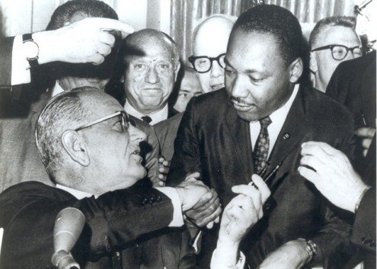
A little background on Title VI
Title VI was enacted as part of the Civil Rights Act of 1964
It prohibits discrimination on the basis of race, color, or national origin in programs and activities receiving federal financial assistance.

Slide 6
Title VI Complaints
DOJ Complaint Process
OCR Complaint Process
Individual or Org files a complaint
Individual or Org Files a Complaint
OCR Investigates Claim
OCR Declines to Investigate
DOJ investigates
DOJ refers to other federal agency
DOJ declines to investigate
OCR Finds a Violation
OCR Doesn’t Find Violation
OCR Orders Remedies
Negotiate Settlement on behalf of U.S.
File a lawsuit on behalf of U.S. in
federal court
Resolution Agreement

Slide 7


Title VI Complaints
Sue a school district in court and use evidence to prove that the district discriminated against students of color.
Need a lawyer to help file and argue the case before the judge.
If you win the case, the judge decides how the school district should fix the problem.
Alert the U.S. Dept. of Ed. Office for Civil Rights (OCR) that a school district should be investigated because it’s discriminating against students of color.
The complaint is just a request for the OCR to open an investigation. You don’t need a lawyer, and the process is supposed to be community-friendly.
School districts often voluntarily agree to fix the problem on their own, instead of waiting for formal findings from OCR.

Slide 8
School Discipline Guidance Package
“Dear Colleagues” Letter
Guiding Principles
Other resources available a thttp://www2.ed.gov/policy/gen/guid/school-discipline/index.html

Slide 9
School Discipline Guidance Package
Why?
Notes:
Inter-agency effort by the Departments of Education and Justice to address the school-to-prison-pipeline and the disciplinary practices that can push students out of school and into the juvenile justice system.
DSC, AEJ, NAACP LDF, Advancement Project and allies begin meeting with SSDI calling for School Discipline Guidance to include community-based solutions.
The Departments acknowledge that “racial discrimination in school discipline is a real problem” and substantial racial disparities in discipline data are not explained by more frequent or more serious misbehavior by students of color.
The Departments acknowledge that without change; there will continue to be long-term, serious consequences; and a direct funnel of students into the school-to-prison pipeline.

Slide 10
Racial Disparities: The Numbers
Percentage of African American students in CRDC | Percentage of African American students suspended once | Percentage of African American students suspended more than one | Percentage of African American students expelled
15% | 35% | 44% | 36%
Notes:
2011-2012 CRDC Collection

Slide 11

Racial Disparities: The Numbers
For every 1 white student
to receive an OSS
3 black students received an OSS
Notes:
2011-2012 CRDC Collection

Slide 12
Dear Colleagues Letter
What school disciplinary practices may be discriminatory
What are the remedies if schools are engaging in discriminatory practices
What are best practices for responding to student behavior and using exclusionary discipline

Slide 13
What the Guidance Tells Us: Discrimination
Different Treatment
  Similarly situated students receive different outcomes for same offense
  Selective enforcement
  Neutral policy that in reality targets one race
  Racially discriminatory motives
Disparate Impact
  Neutral policy with no intent to discriminate that has the effect impacting students of a particular race

Slide 14
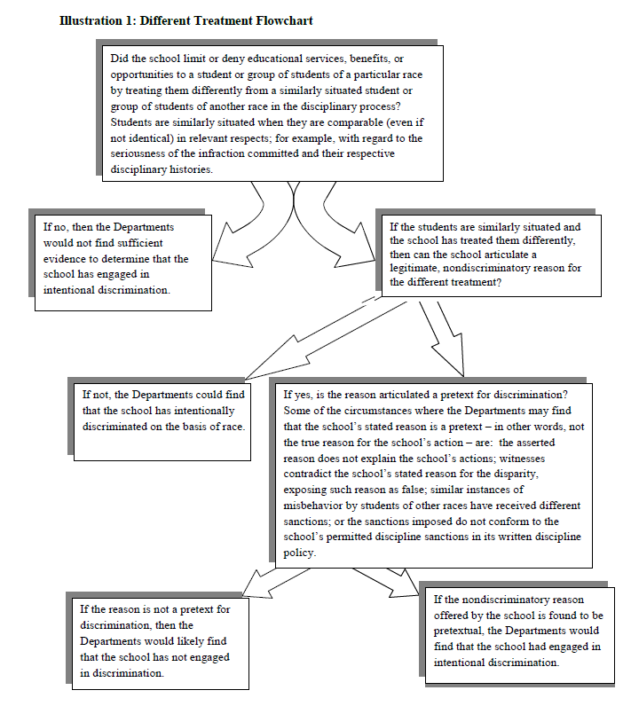
Different Treatment

Slide 15
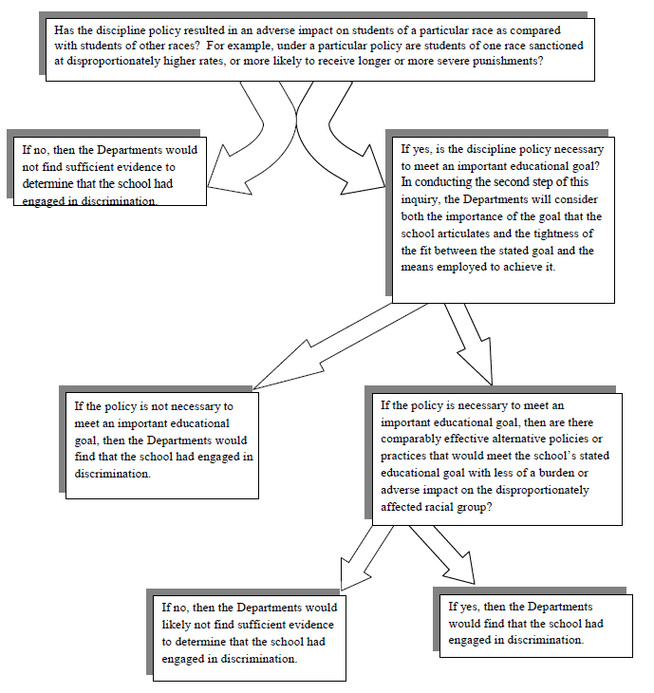
Disparate Impact

Slide 16
Remedies
Revising discipline policies, provide clear definitions of infractions, ensure that consequences are fair
Developing and implementing strategies for teaching, including the use of appropriate supports and interventions, which encourage and reinforce positive student behaviors and utilize exclusionary discipline as a last resort;
Providing training to school staff
Providing school-based supports for students who are struggling
Conducting annual reviews with all stakeholders to discuss how discipline is working in the school

Slide 17
What The Guidance Tell Us:
Policies & Practices
Red Flags
Best Practices
Subjective offenses (p.20)
Policy that doesn’t mention race but targets students of a particular race (this could apply to rules about hairstyles, clothing, etc.) (p.8)
Zero tolerance policies for being tardy to class; possessing a cell phone; insubordination or acting out; or being out of uniform (p. 12)
Corporal punishment(p.12)
Exclusionary discipline for truancy (p. 12)
Intentional school climate creation (p. A-2)
Defined role for law enforcement (p. A-3)
Range of responses that are proportional, including positive alternatives to exclusion (p. A-4; A-6)
Re-entry supports and services (p. A-6)
Data collection & analysis (p. A-7)
Training and development for school staff (p. A-3)

Slide 18
Best Practices: School Climate
School and district wide programs like peer mediation and restorative justice
School-based supports like counselors, social workers, nurses, and psychologists
Development of social and emotional competencies
Training on classroom management, conflict resolution, de-escalation, and cultural competencies

Slide 19
Best Practices: Infractions & Sanctions
Clearly defined, non-subjective offenses with specific and objective criteria
Range of sanctions with the understanding that exclusion is for only the most serious offenses
Guidance for staff who are applying the range of sanctions
Alternatives to using exclusionary discipline

Slide 20
Best Practices: Law Enforcement
Clearly defined and formalized roles and responsibilities
Differentiate between school discipline and school safety/serious crimes
Training on bias-free policing and implicit bias, child development, and cultural competency
Data collection and monitoring

Slide 21
Best Practices:
Community Involvement
Involve families & students in development and implementation of discipline policies
Encourages districts to solicit family, student, & community input through committees or taskforces
Regularly review and evaluate discipline policies & practices
Districts should commit to plans of actions to address STPP and racial disparities

Slide 22
Reactions
From your vantage point in the school-justice system, is the guidance being followed?
If yes, in what ways? What is working?
If no, why not? What are barriers to the types of best practices?

Slide 23
Strategies For Using Guidance
To Reform Policies & Practices
Review codes of conduct to see if there are any red flags
Revise codes of conduct based on best practices
Include the community:
  Release data
  Create process for reviewing & revising code with community input
  Develop plans for acknowledging and addressing racial disparities

Slide 24
Support Available
National Institute for Justice Comprehensive School Safety Initiative
  http://nij.gov/funding/pages/fy14-dear-colleague-school-safety-knowledge-building.aspx
  Applications due July 10
Department of Education Regional Support Centers

Slide 25
Questions & Next Steps
Kaitlin Banner
kbanner@advancementproject.org
202-728-9557
Matt Cregor
mcregor@lawyerscom.org
617-988-0609

