Slide 1
Working with the
TEEN BRAIN
Understanding some key factors about how Youth Think—Or Don’t

Slide 2
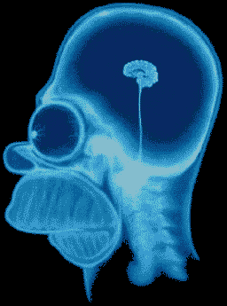

Slide 3
How are police prepared to work with youth?

Slide 4

In-Service Police Training
IACP 2011 Juvenile Justice
Training Needs Survey of
Chiefs:
No training after academy,
No requirement for in-service training,
No in-service training in juvenile justice for 5 years or > due to lack of funding.

Slide 5
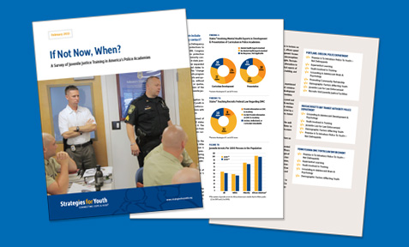
Academy Recruit Training
SFY Study of Police Officer
Standards & Training (POST)
Curriculum 2013:
Average duration is 6 hours,
90 to 95% of curricula is legal; not always updated,
Most state provide no training on youths’ developmental and mental health issues.

Slide 6
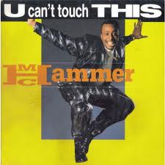
Why Do Police Need This Information?
Juvenile developmental
characteristics such as
impulsivity, self
centeredness, and
resistance to authority
Increase the chances that
police-juvenile encounters
will involve conflict,
disrespect, and
confrontational behavior.

Slide 7

Developmental Competence
Cannot assume
youth conduct:
Intentional/purposeful mens rea
Results from clarity about consequences
Self-aware

Slide 8
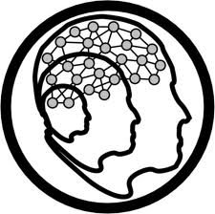
Developmental Competence
Universal stages of development
Adults & institutions working with children & youth must:
Understand
Apply the Knowledge
Adjust Responses

Slide 9
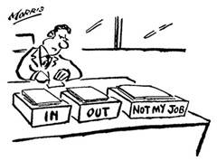
What is Your Responsibility?
Notes:
A basic premise of this training is that we are the adults and have a responsibility to maintain a professional demeanor. Is it your responsibility to be a role model for kids? To mirror the behavior you want from them?

Slide 10
Some Facts to Keep in Mind
When Working with Youth

Slide 11
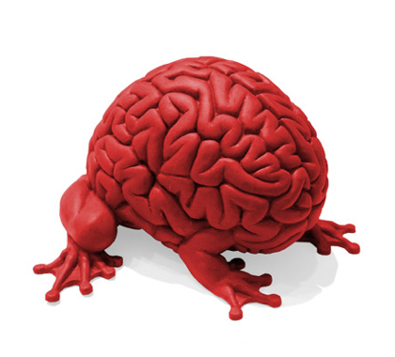
They leap without looking – because they are not yet prepared to see!
Notes:
We are going to spend time talking about brain development to ensure that you have the knowledge needed to differentiate problematic adolescent behavior from typical adolescent behavior. We hope you will share the skills that you have used to de-escalate situations involving agitated or defiant youth and how you prevent situations from escalating in the first place. We will share tactics we have learned over the years and from your peers across the country.

Slide 12
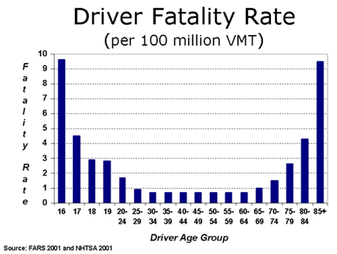
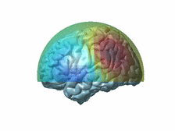
Why Do Teens & Elderly Lead the Nation in
Traffic Fatalities?
Isn’t
“Done” Yet!
Losing
It!
Notes:
Why do we have laws that say you cannot drive with your peers when you first get your license? Because we know without the experience to make you a good driver, the distractions can be deadly. We need to be that part of the brain for kids. The part that thinks of the consequences…We will talk about how we can help guide kids in the right direction.

Slide 13

T
Notes:
I think everyone in this room would agree that with adolescents and teen-agers this is often the case. Much of the behavior you see is normal adolescent development. Together we will come up with ways to interact positively with the youth you come in contact with.

Slide 14
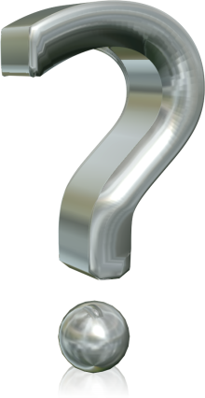
What causes
BEHAVIOR
Why kids do what they do…
Notes:
We will talk about nature vs. nurture, and brain development.
You all have a professional skill set that you have developed for working with people. Would you all agree that you need specific and sometimes different skills when working with kids?
To set the tone for this training I would ask that you all be open minded to this information. There is always something to learn and there is a lot of experience in this room that we hope you will share. If we misspeak or you totally disagree with anything said we ask that you challenge us. Only through open dialog will we be able to make a positive impact.

Slide 15
Construction Ahead
Amygdala
Judgment
Emotion
Motivation
Physical coordination
Prefrontal Cortex
Nucleus Accumbens
Cerebellum
Construction Completes @ Age 25
Notes:
The pruning of brain structures generally occurs from the back of the brain to the front. Thus, structures at the back of brain finish the pruning first, making these structures the first to mature. Structures at the front of the brain finish pruning last, and it is these structures that do not complete maturation until about age 24.
There are four primary brain structures from the back to the front of the brain – cerebellum, nucleus accumbens, amygdala and prefrontal cortex – that are noteworthy in terms of how their differential development may impact adolescent behavior.
The first area to be finished with pruning is the cerebellum. Located at the back of the brain , this structure controls physical or motor coordination.
Next are the nucleus accumbens, which is responsible for motivation, and the amygdala, which identifies and controls emotion. The nucleus accumbens is responsible for how much effort the organism will expend in order to seek rewards. A developing nucleus accumbens is believed to contribute to the often-observed tendency that teenagers prefer activities that require low effort yet produce high excitement. Real-world observations bear this out: teenagers tend to favor activities such as playing video-games, skate boarding and, unfortunately, substance use. The amygdala is responsible for integrating how to emotionally react to pleasurable and aversive experiences. It is hypothesized that a developing amygdala contributes to two behavioral effects: the tendency for adolescents to react to situations with “hot” emotions rather than more controlled and “cool” emotions, and the propensity for youth to mis-read neutral or inquisitive facial expressions from other individuals as a sign of anger. (Instruct parents: “Smile as you ask your teenager ‘How was school today?’”)
And one of the last areas to mature is the structure named the prefrontal cortex, located just behind the forehead. Sometimes referred to as “the seat of sober second thought,” it’s the area of the brain responsible for the complex processing of information, ranging from making judgments, to controlling impulses, foreseeing the consequences of ones’ actions, and setting goals and plans. An immature prefrontal cortex is thought to be the neurobiological explanation for why teenagers show poor judgment and too often act before they think.

Slide 16
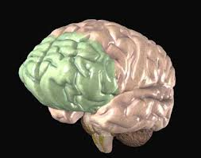
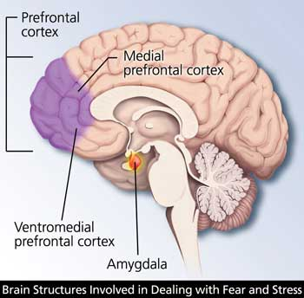
PREFRONTAL CORTEX
VERY IMPORTANT!

Slide 17
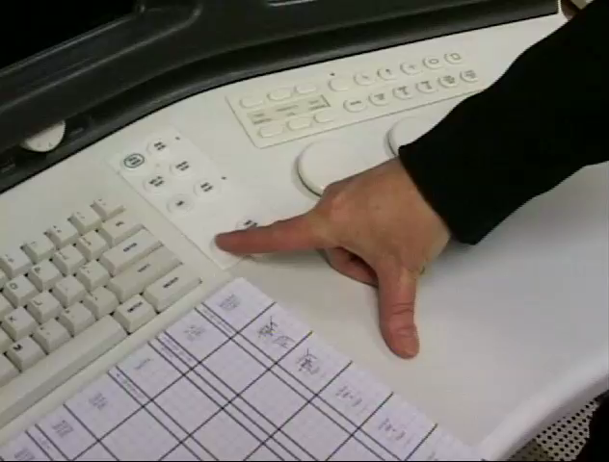
Kids Process Through Amygdala
The Teen Brain Film:

Slide 18
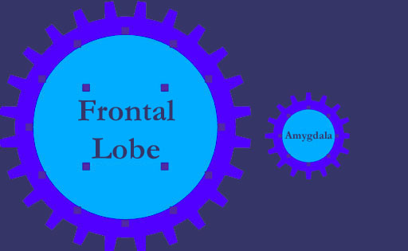
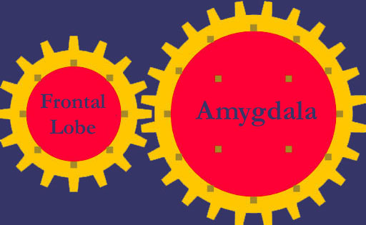
Teens’ Enlarged Amygdala:
No Braking Device

Slide 19

PREFRONTAL CORTEXT
“CEO” of the brain
Moderates “correct” behavior
Takes in information from all senses and orchestrates thoughts and actions to achieve specific goals

Slide 20
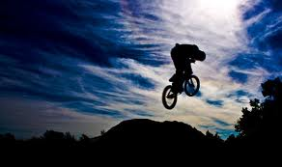
PREFRONTAL CORTEX
Adapt to new situations
Impulse control
Moderate intense emotions

Slide 21
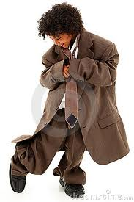
PREFONTAL CORTEXT
Last area to mature; maturation occurs in adolescence and into young adulthood

Slide 22
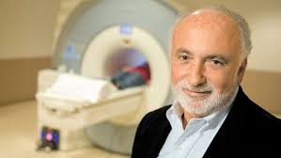
Notes:
Lawrence Steinberg, Temple Univ

Slide 23

Notes:
Stoplight test; yellow light—go for it or not (sometimes much time, sometimes little

Slide 24
“ … although the sample as a whole took more risks and made more risky decisions in groups than when alone, this effect was more pronounced during middle and late adolescence than during adulthood. Thus, relative to adults, adolescents are more susceptible to the influence of their peers in risky situations.”
Gardner, Margo, and Laurence Steinberg. "Peer Influence on Risk Taking, Risk Preference, and Risky Decision Making in Adolescence and Adulthood: An Experimental Study." Developmental Psychology 41.4 (2005): 625-35. Print.

Slide 25
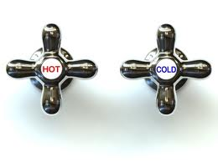
“Hot and Cold” Cognition
By 15, most teens are able to generate “safe/sound” hypothetical decision-making
BUT, teens still frequently participate in high risk behaviors
This is called “HOT & COLD” cognition

Slide 26
And we’re just speaking about normative brain development.

Slide 27
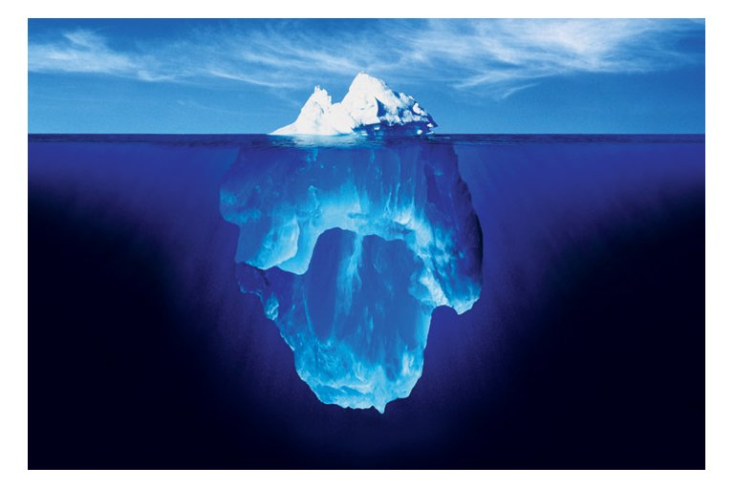
What you see isn’t half of it…

Slide 28
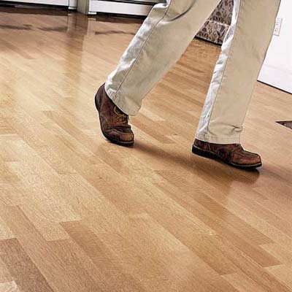
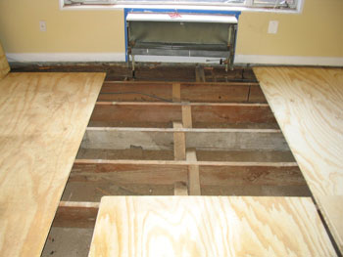
Exposure to Trauma:
Impact on Young Minds

Slide 29
What percentage of youth have a
diagnosable mental health disorder?
1 in 10
1 in 5
1 in 2

Slide 30
Top 5 Mental Illnesses Among Adolescents
Anxiety Disorders
Depression
Behavior Disorders (i.e. Oppositional Defiance Disorder, etc.)
Autism Spectrum Disorder
Mood Disorders (i.e. Depression, Bipolar Disorder, etc.)
Children’s Mental Health Ontario

Slide 31
Best Practices
for Working with Youth

Slide 32
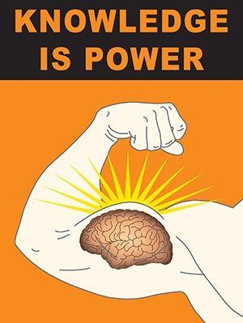
Knowledge of how
the teen brain
perceives,
processes, and
reacts
is essential
for
dealing with youth.

Slide 33
Tactics for Working with Youth
#1
GIGA: Good Intent Gone Awry

Slide 34
Tactics for Working with Youth
#2
SAC:
Situation
Alternatives
Consequence

Slide 35
Tactics for Working with Youth
#3
Connect the Dots

Slide 36
Tactics for Working with Youth
#4
Distraction:
Is that a bird?
Is it hot in here?
Do you smell that?

Slide 37
Tactics for Working with Youth
#5
Help them Re-Self-Regulate:
Don’t escalate with them
CCC
Breathing

Slide 38
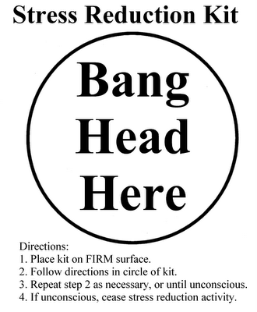

Slide 39
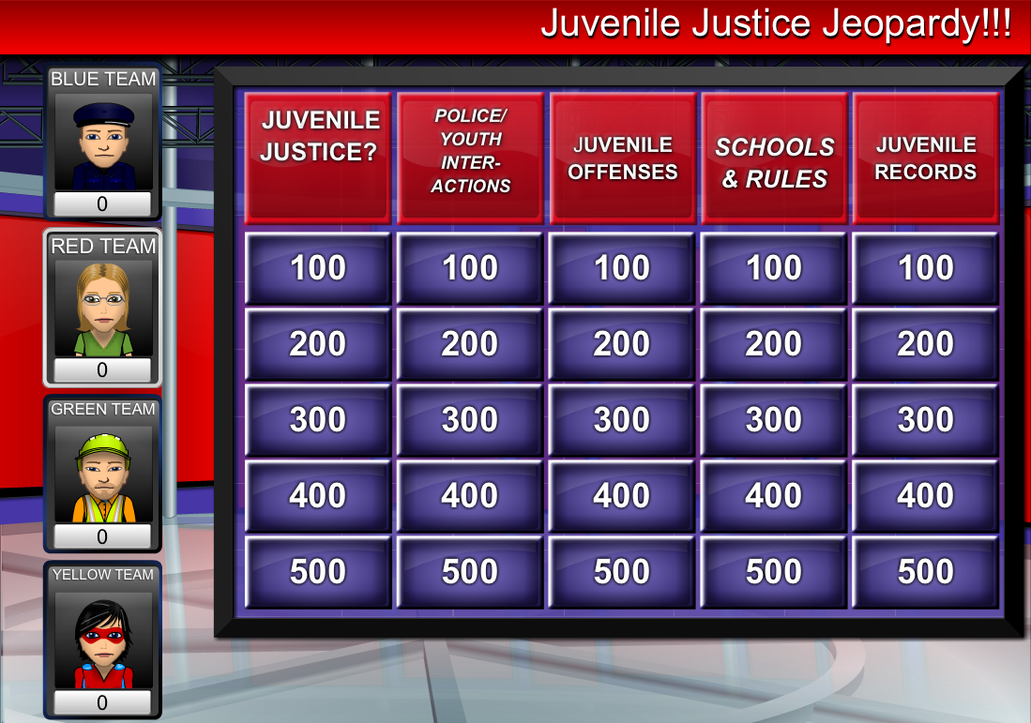
EXPLAIN IT! TALK ABOUT IT!
Make assumptions clear
Model ways students should address anticipated disputes
Connect the dots
Juvenile Justice Jeopardy

Slide 40
And if that’s not enough of a reason,
consider this:

Slide 41

Costs
Pressure to reduce use of detention and incarceration
Fewer law enforcement resources
  Officers out of service
  Court costs/OT

Slide 42

Risk Management
Media coverage
Legal Challenges & Costs:
  Legal fees
  Department legitimacy
  Community relations
  Morale

Slide 43

Legitimacy of Law Enforcement
Positive Socialization of youth to relations with authority
Hold your fire!
Don’t dilute police authority
Notes:
Begin with information on cuts to municipalities; every one is hurting and the need to use existing resources carefully and wisely is important and can help ensure that good decisions are made.
You might want to remind officers that recent studies show that arrest and detention of youth is most likely to lead to recidivism; according to one study, this approach to minor youth crime increased SEVEN FOLD the recidivism rate.

